Slide 1


Rest Assured API Automation
Day 3 - Parameterizing Get and Different Body types for POST

Slide 2
Parameters in RESTful APIs
There are two types of parameters.
1. Path Parameter
The parameter value is simply part of the URL that you call when you invoke the API.Path parameters are part of the endpoint itself and are not optional.
http://zippopotam.us/us/90210 us and 90210
http://zippopotam.us/ca/B2R ca and B2R
/service/myresource/user/{user}/bicycles/{bicycleId}
2. Query String Parameter
Query string parameters appear after a question mark (?) in the endpoint. The question mark followed by the parameters and their values is referred to as the “query string.”
In the query string, each parameter is listed one right after the other with an ampersand (&) separating them. The order of the query string parameters does not matter.
http://zippopotam.us?text=mango text is key and mango value
http://zippopotam.us?text=banana text is key and banana value
/surfreport/{beachId}?days=3&units=metric&time=1400
/surfreport/{beachId}?time=1400&units=metric&days=3

Slide 3
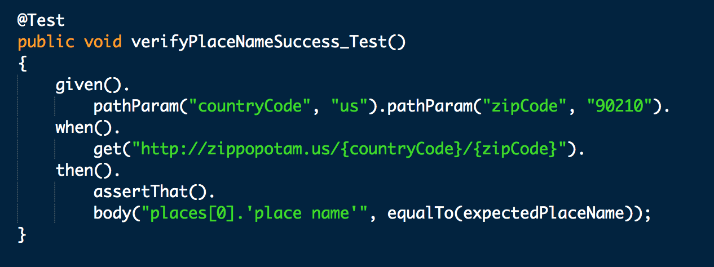
Parameterize Rest Assured Tests : Hard Coded for GET request
1. Hard coded path parameter values in test method
Run for that same data only
Need to change code if we want to modify the parameters

Slide 4
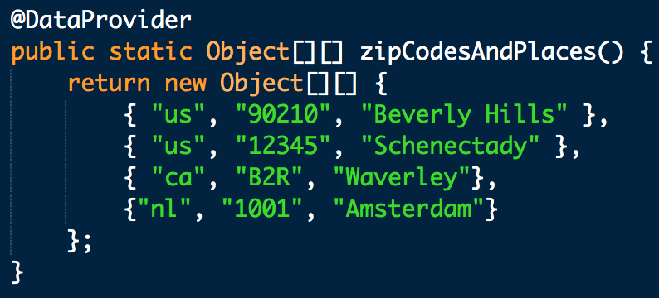
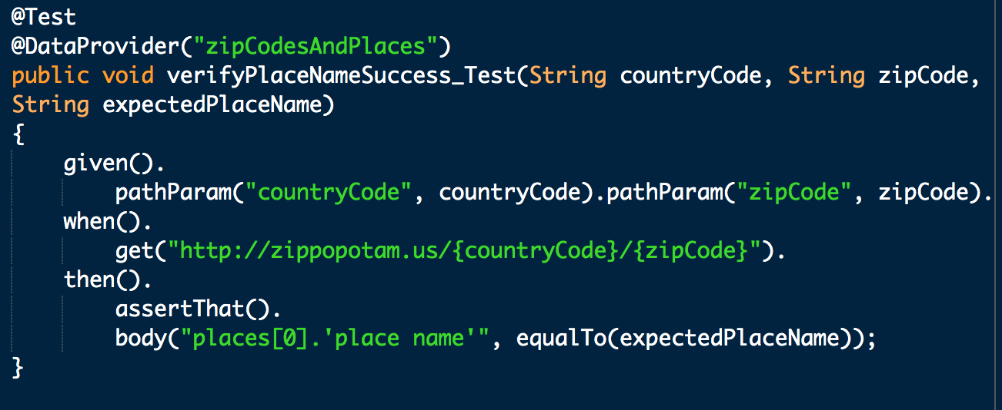
Parameterize Rest Assured Tests - Data Provider for GET request
2. Data Provider : Define Data provider and put all required values in that method.
Run data driven test cases
Need to change Data Provider in code
to modify/add parameters

Slide 5
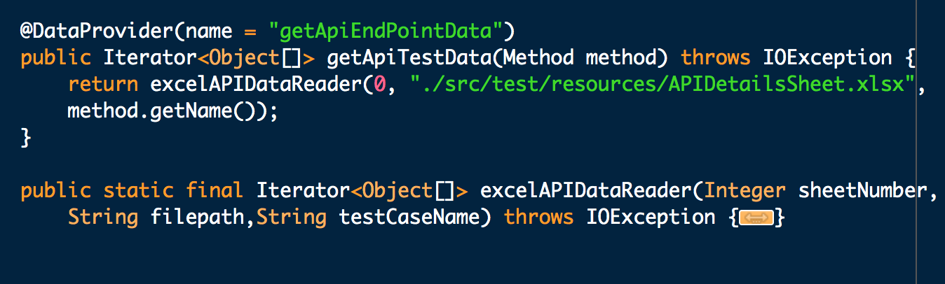
Parameterize Rest Assured Tests - Data Provider (Excel) GET Request
2. Data Provider : Define Data provider and put all required values in excel sheet.
Run data driven test cases
Need to change Excel sheets
to modify/add parameters
Need to write code to read excel file.

Slide 6
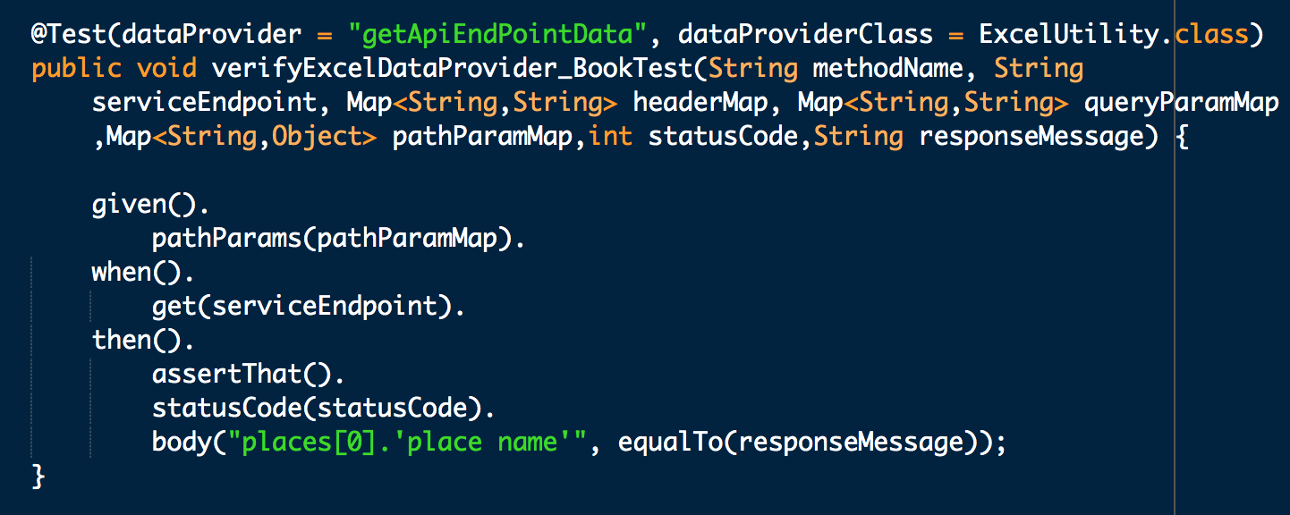
...

Slide 7
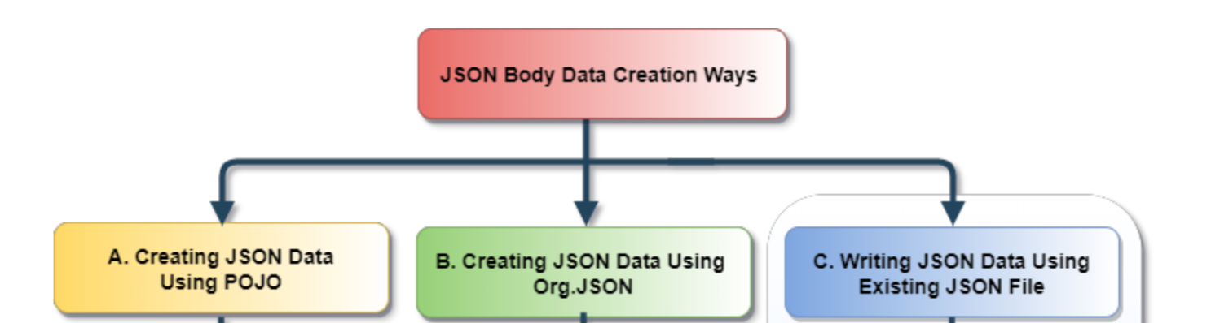
Rest Assured Tests: POST request
Need some data(body) which we want to post.
Post request writes the data on the given resource.
We can create body data using:
Using JSON File
Using Org.JSON/org.json.simple
Plain Old Java Object (POJO) and Maps

Slide 8
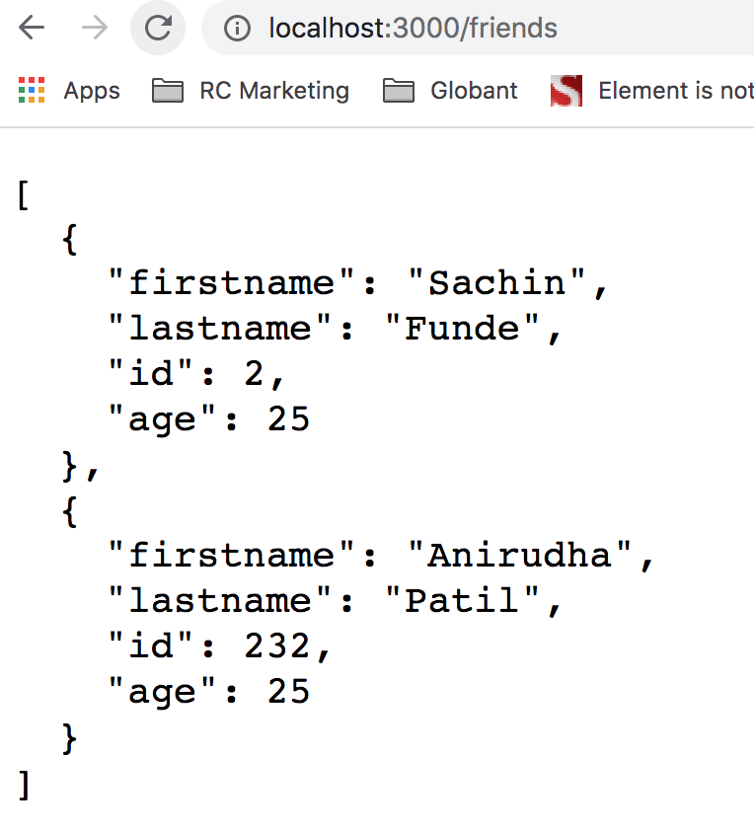
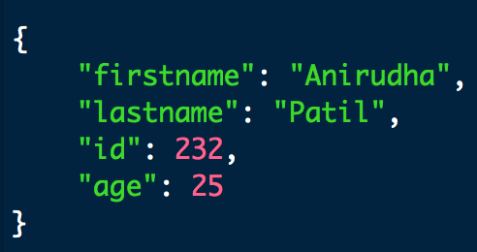
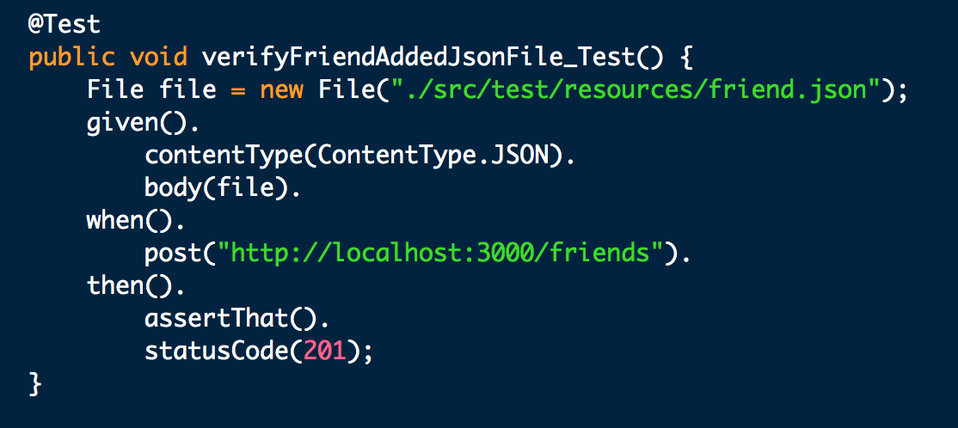
Rest Assured Tests - POST request with JSON file
1. JSON file :
Can use JSON file directly as Body of POST call

Slide 9
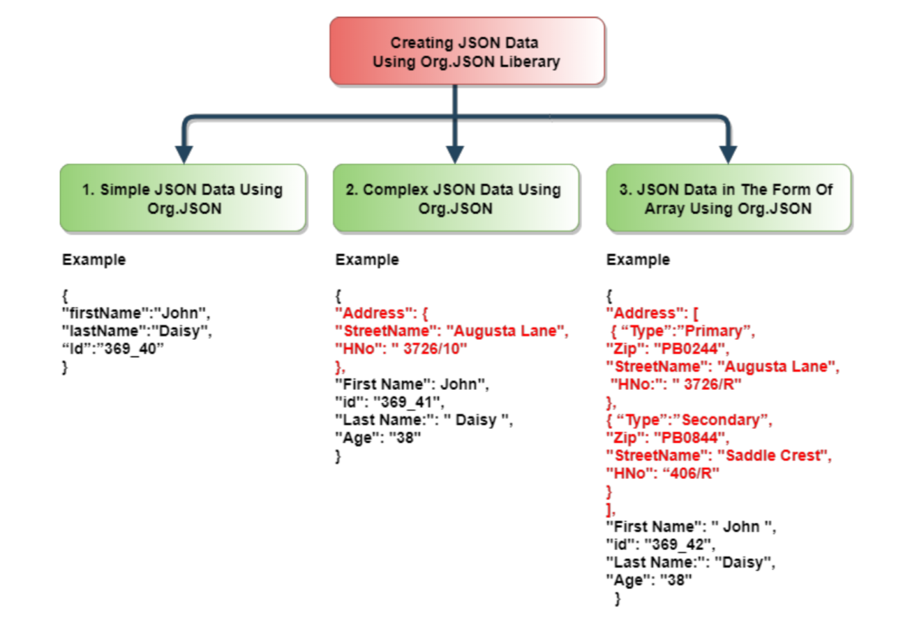
Rest Assured Tests - POST request with org.JSON
2. org.JSON/org.json.simple Libraries :
These libraries provides the way to interact with JSON data.
<dependency> <groupId>org.json</groupId>
<artifactId>json</artifactId>
<version>20190722</version>
</dependency>

Slide 10
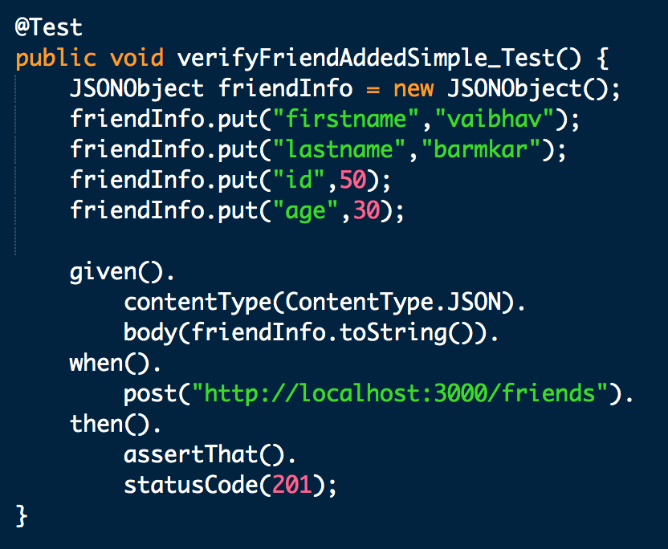
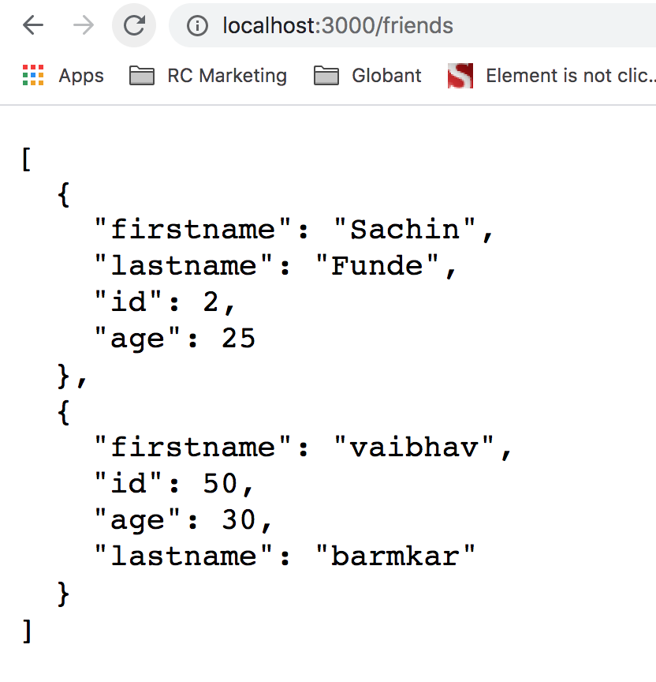
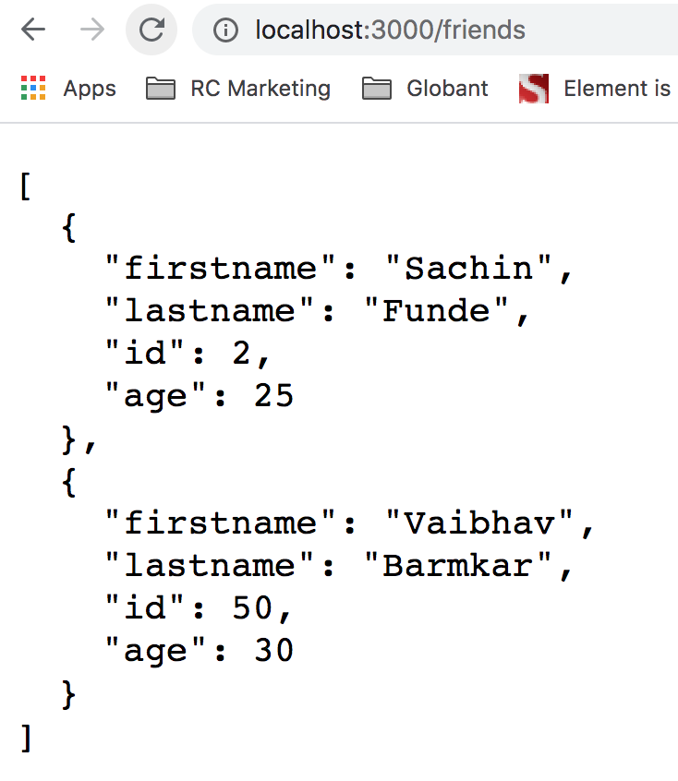
...
a. Simple Data :
Need to create an object of JSONObject class and we have created friendInfo and we will be using object of the JSONObject class created along with PUT method to assign the values to the keys as shown below
Need to convert the object of the JSONObject class to string and then only passed in the body method.

Slide 11
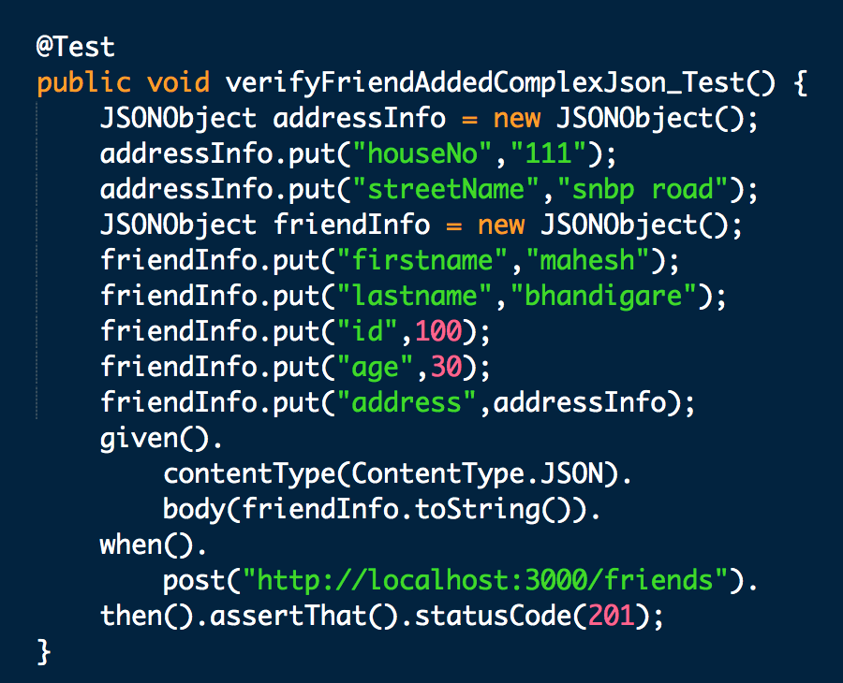
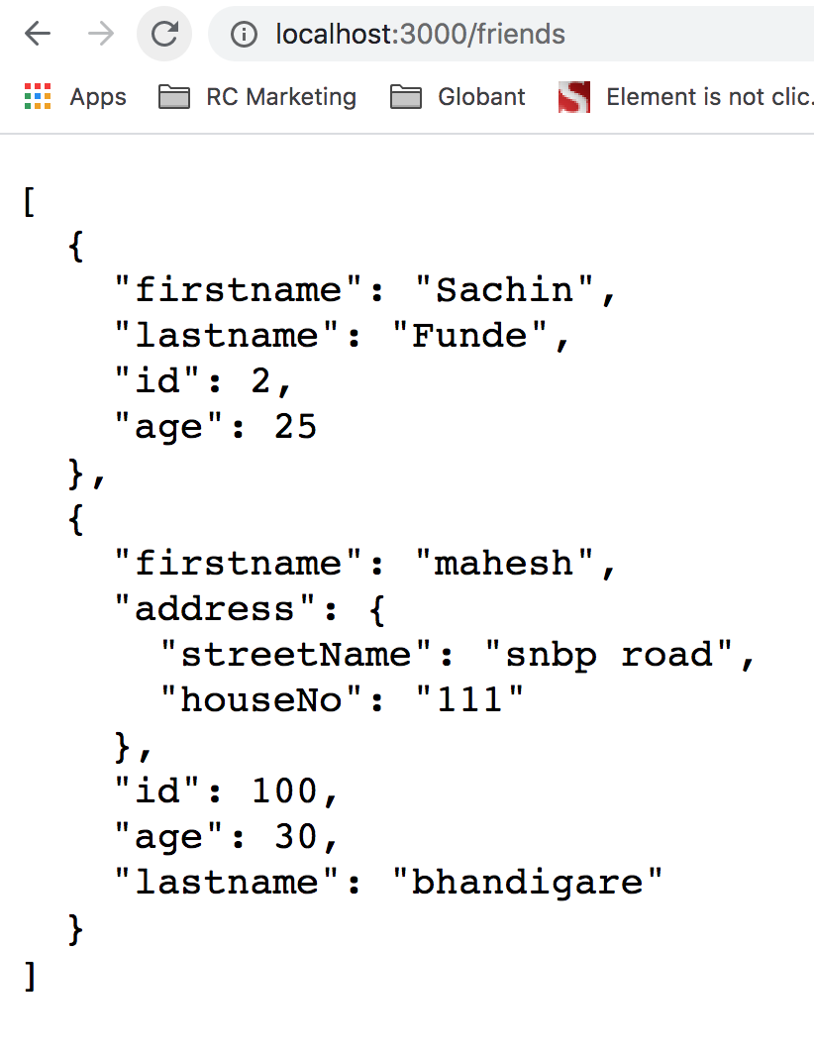
...
b. Complex Data :
Create an object of JSONObject class and for that we have created AddressInfo object. This object of the JSONObject class created is used along with .put method to assign the values to the keys. Create another object of JSONObject class as shown below:

Slide 12
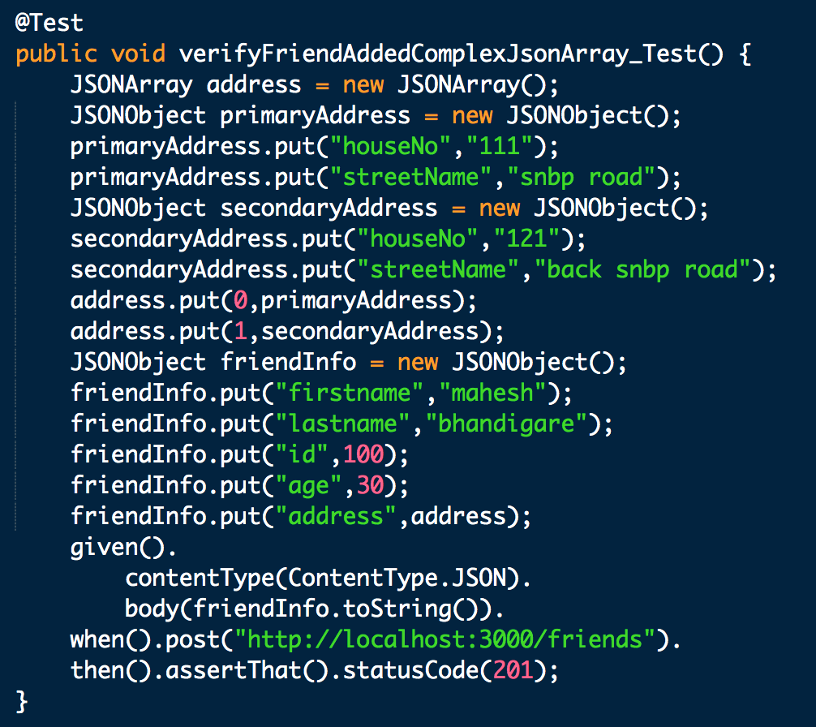
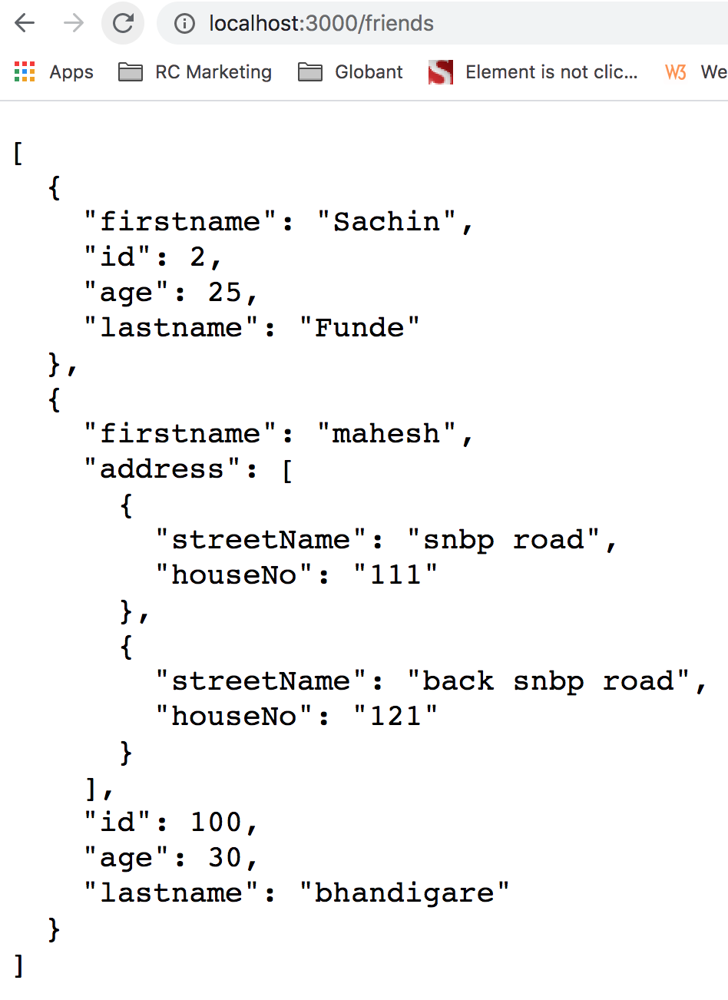
...
c. Complex Data with JSON array :
For creating the body data in the form of array with Org.json we need to create an object of JSONArray class and for that we have created friendInfo object. This object of the JSONObject class created along with .put method will be used to assign the values to the keys as shown below:

Slide 13


